Slide 1
Warehouses Management System
Srinadh Divakaruni

Slide 2
Problem Statement
Warehouse Management System is a software application designed to support and optimize warehouse operations.
This helps in tracking of inventory levels, managing stock locations and improving overall efficiency and functioning of warehouses.

Slide 3
Technologies used
This application is built on a microservices architecture which includes scala, play-framework, Kafka to produce real time messaging and event logging.
Key Features:
Frontend: Static web application which will have the login, sign up functionalities and also the users can interact with the UI which is built and deployed using Play framework.
Backend: Restful APIs implemented using scala, play framework to provide functionalities like handling user login, sign up, and logging the events into the database.
Kafka: Leveraged Apache Kafka for robust, real-time message processing and seamless data streaming and event logging.
Database: Used MySQL database for storing the user information and products information and event logs.
Docker: Used Docker to containerize our application, ensuring streamline deployments.

Slide 4
Components
Microservices:
Warehousing Service
ActivityTracker Service
Models:
User
Products
Activity

Slide 5
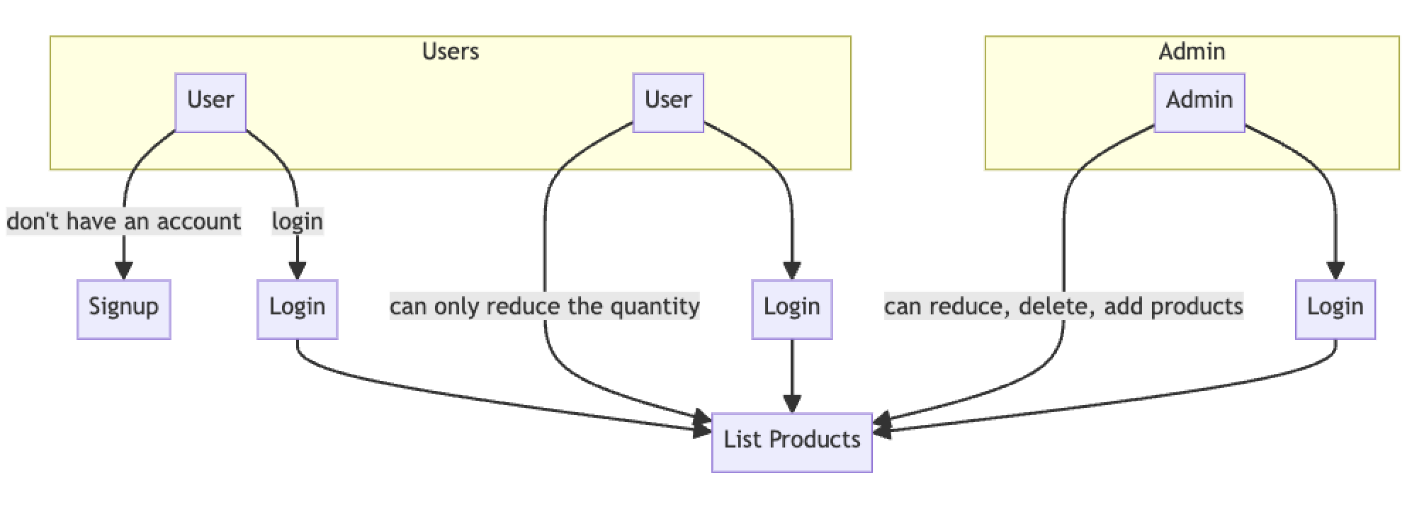
Architectural Design

Slide 6
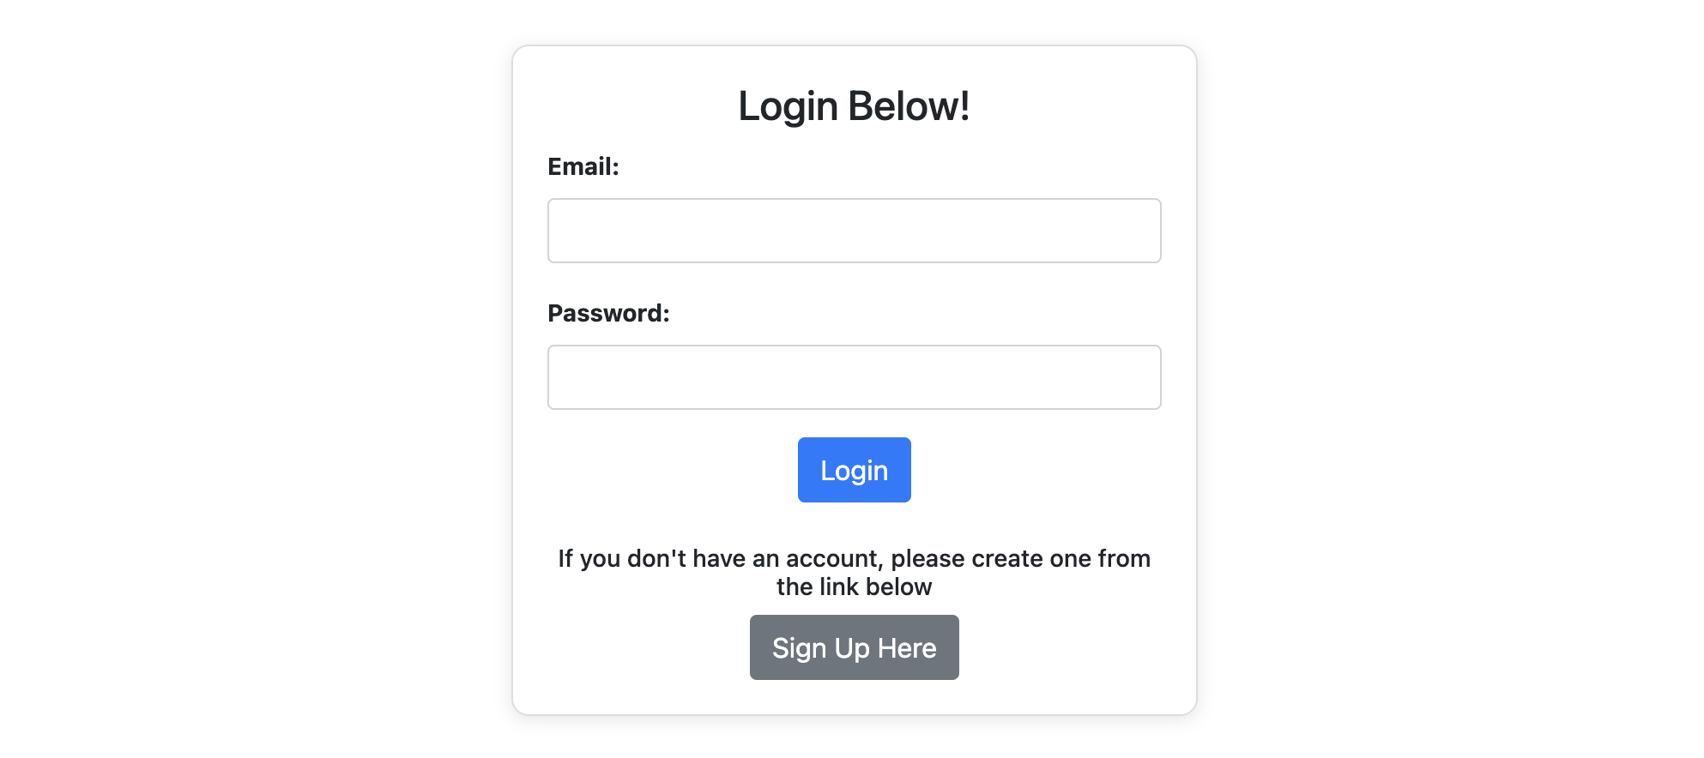
Login page

Slide 7
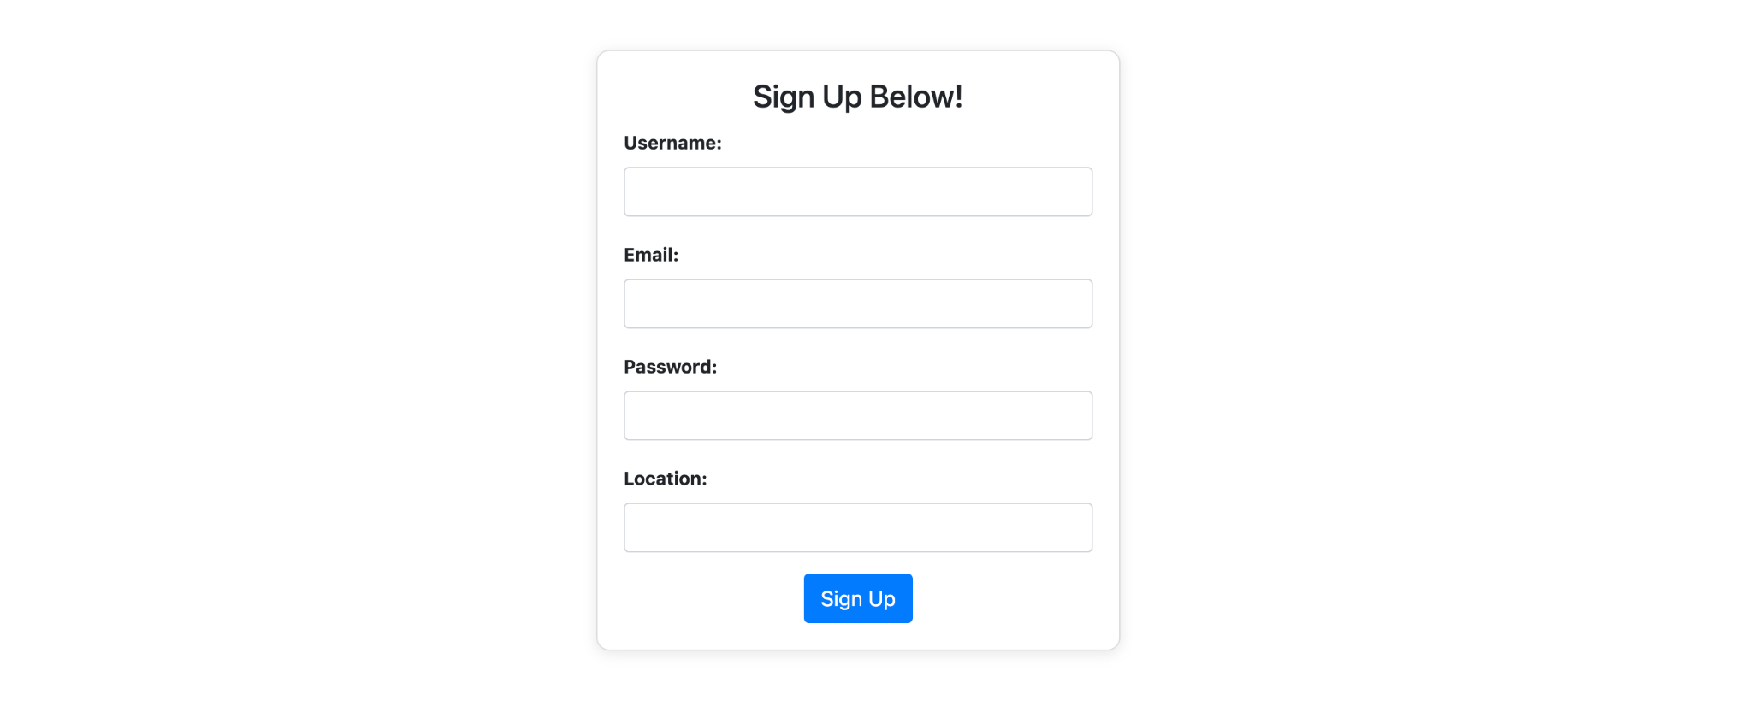
SignUp Page

Slide 8
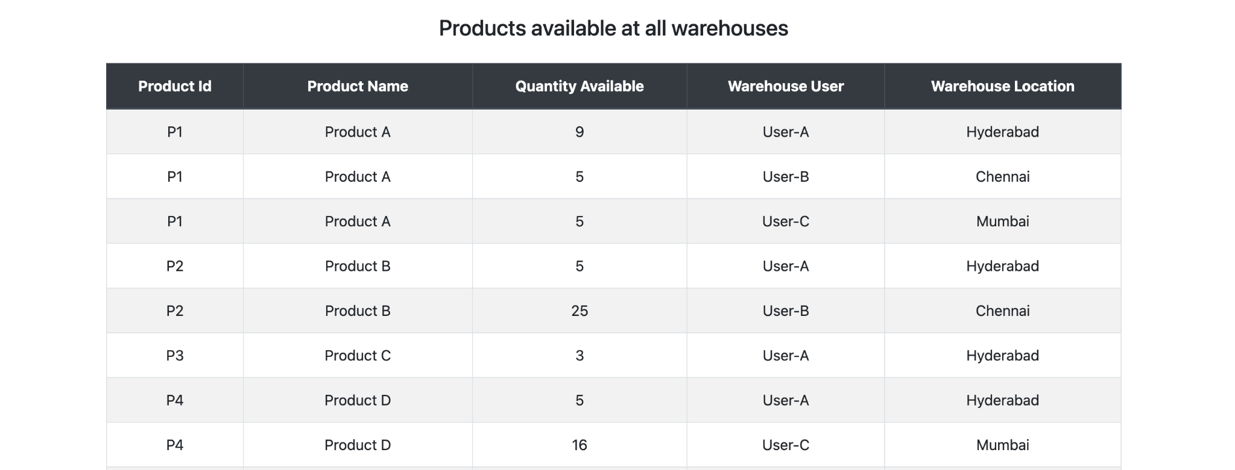
Product listing page for Admin

Slide 9
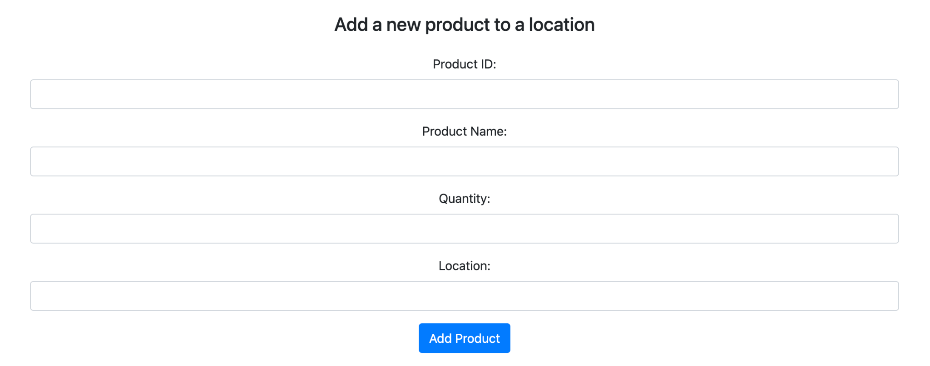
Admin can add a product

Slide 10
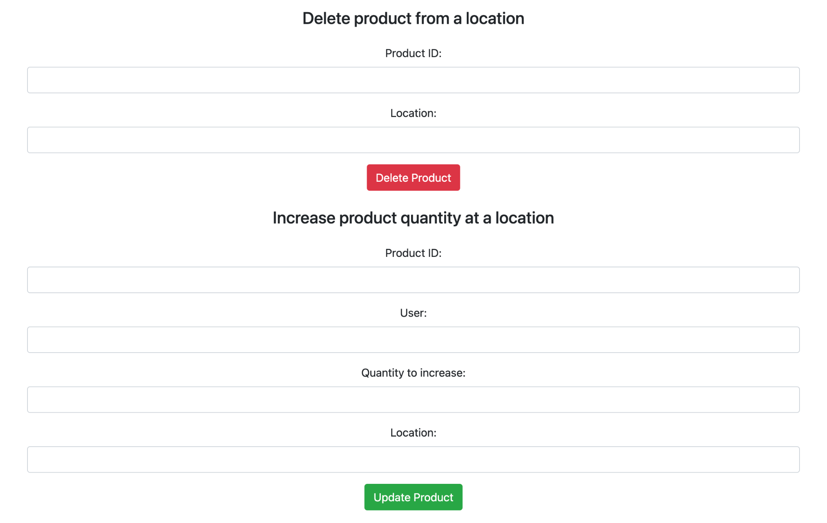
Admin can delete a product or increase the quantity

Slide 11
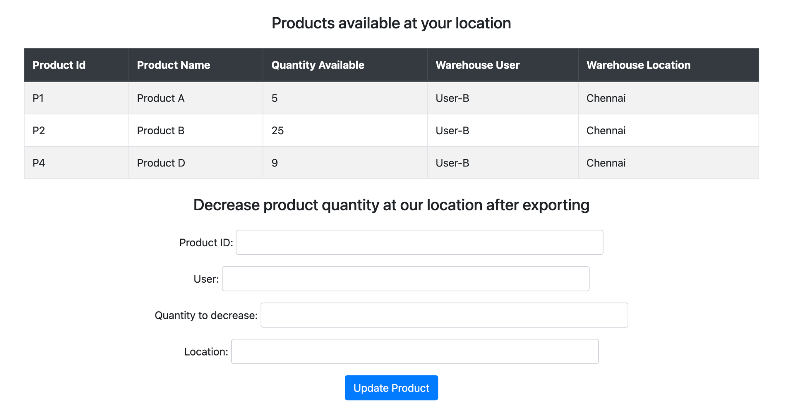
User page (can only reduce the quantity)

Slide 12
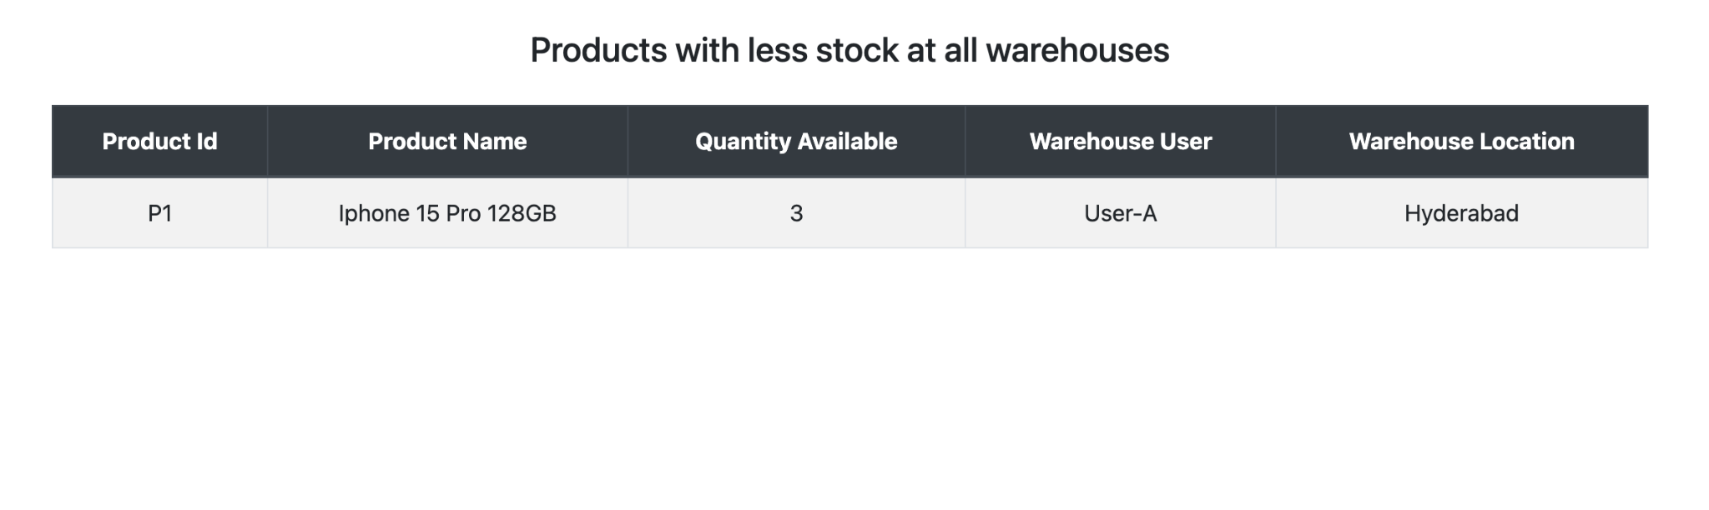
Admin can see where the stock is less

Slide 13
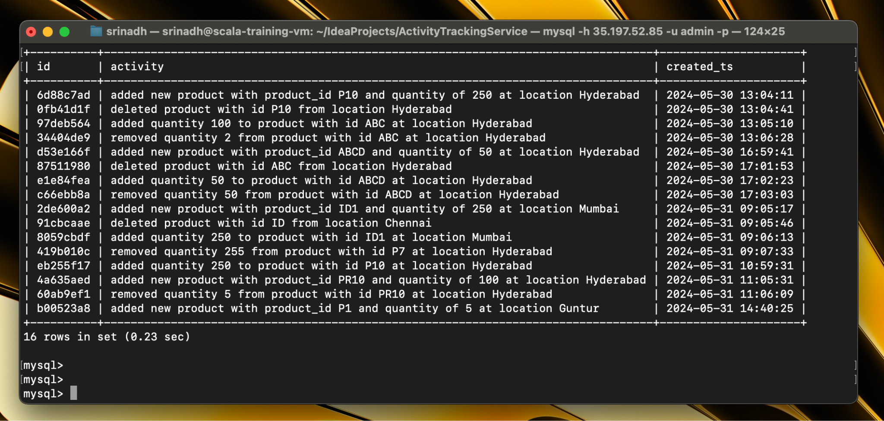
Activities logged in the mysql db

Slide 14
Thank you

